Slide 1
WEL-COME

Slide 2

Seminar On
PESTICIDE APPLICATION TECHNIQUES
DELIVERED BY
POST GRADUATE INSTITUTE,
DR. PANJABRAO DESHMUKH KRISHI VIDYAPEETH, AKOLA 2011 - 2012

Slide 3
Pesticides
Pesticides are substances or mixtures used to control plant and animal life for the purposes of increasing and improving agricultural production, protecting public health from pest-borne disease and discomfort, reducing property damage caused by pests, and improving the aesthetic quality of outdoor or indoor surroundings. Pesticides are used widely in agriculture, by homeowners, by industry, and by government agencies. The largest usage of chemicals with pesticide activity, by weight of "active ingredient" (AI), is in agriculture. Agricultural pesticides are used for cost-effective control of weeds, insects, mites, fungi, nematodes, and other threats to the yield, quality, or safety of food.

Slide 4
Plant Protection Equipment
Selecting the right equipment for pesticide application is important for successful pest control. The correct usage of equipment and its proper maintenance are important factors which affect the ability to place pesticides on target more economically and effectively. The choice of equipment depends on its specific use and the need of a particular pest control measure.

Slide 5
Different Types of Plant Protection Equipment Generally Used
Hand sprayers and atomizers
Hand compressed sprayers
Knapsack sprayers
Tractor-mounted sprayer
Motorized knapsack mist blowers
Ultra low volume or controlled-droplet applicators (ULV/CDA)
Fogging machines/ fogair sprayers
Hand-carried dusters
Hand-carried granule applicators
Power dusters
Aerial application (Aircraft sprayers)
Injectors and fumigation equipment.

Slide 6
Process Description
Application Methods
Pesticide application methods vary according to the target pest and to the crop or other value to be protected. In some cases, the pesticide is applied directly to the pest and in others to the host plant. In still others, it is used on the soil or in an enclosed air space. Pesticide manufacturers have developed various formulations of AIs to meet both the pest control needs and the preferred application methods (or available equipment) of users. The types of formulations are dry, liquid, and aerosol.

Slide 7
Dry formulations can be dusts, granules, wettable and soluble powders, water dispersible granules, or baits. Dusts contain small particles and are subject to wind drift. Dusts also may present an efficacy problem if they do not remain on the target plant surfaces. Granular formulations are larger, from about 100 to 2,500 micrometers (μm), and are usually intended for soil application. Wet table powders and water-dispersible granules both form suspensions when mixed with water before application. Baits, which are about the same size as granules, contain the AI mixed with a food source for the target pest (e. g., bran or sawdust).

Slide 8
The Role of Chemical Control
To control insects, pest and plant disease or weeds it is necessary to spray the plant with insecticides pesticides and herbicides. The various chemicals both organic and inorganic compounds are available to fight the plant disease and pest.
The discovery of organic pesticides provided man with new and powerful weapons for his incessant war against insect, pest, disease and weeds. Since the introduction of DDT, MCPA and 2.4 D in the 1940 pesticides have played a measure role in crop production and the control of vector born diseases; today there use is organized throughout the world as effective, relatively simple and quick methods. Without chemical control man crop would be ravaged by diseases insect test and weeds and survey loss of food production would be occurred. For example cotton is an important source of old and protection as well as fiber but production can be drastically reduced by incest damage, so much so that over a third of insecticides used in agriculture are applied to this crop.

Slide 9
Also weed composition in the initial stage of crop growth can be so severe that plant remains stunted and final yields are a mere fraction of to potential. Virtual weeds free condition is not possible using a range of herbicides available. Herbicides are particularly useful for infra row breeding equally when it is difficult to hoe in planted row without damaging the crop. Shortage and increased cost of labors specially at critical period is often the key constrain to improve yields.
Even if a farmer in the tropic wishes to apply herbicides it is often difficult, if not impossible, for him to obtain sufficient water to spray, especially at the beginning of the season when the demand for labour to sow crops at a peak. New techniques requiring little water are being adopted in the tropes thus increasing the weed free area that each farmer can grow and protect from insects and disease.
Chemicals control is still the only effective method of controlling most insects pest, weeds and dieses despite intensive research into alternatives methods. As Smith (1970) pointed out, pesticides remain our most powerful tool in pest management is spite of recent popular pressure to have their use curtailed.

Slide 10
FORMULATIONS
A formulation is a mixture of the active ingredient in a pesticide with other inert (inactive) substances. Different formulations may be used differently. Some are to be used direct from the package, while others need to be diluted with water, oil, or other carriers. The reason for mixing the active ingredient with other substances is to make handling and application safer, easier, and more accurate.
Some active ingredients do not dissolve in water or oil. Others can only be manufactured as solids. Still others are liquids or gases in their original forms. By mixing the active ingredient with other materials such as solvents, wetting agents, stickers, powders, or granules, manufacturers produce formulations that can be handled accurately and safely by application machinery. A few pesticides are now formulated for controlled release. These pesticides allow the active ingredient to be slowly released after application. This provides better control for certain pests at possibly lower rates and over a longer period of time.

Slide 11
How to Choose a Formulation
A single pesticide is often sold in different formulations. Different formulations of the same active ingredient often behave differently. For example, some types of formulation may mix in water better, while others may increase the chance of crop injury. Choose the formulation that is suitable for the job. Things to consider include
  Percent of active ingredient.
  Ease in handling and mixing.
  Personal safety risk.
  Type of environment (agriculture, forest, urban, etc.).
  Effectiveness against the pest. Page 4-59
  Habits of the pest.
  The crop to be protected.
  Type of application machinery.
  Danger of drift or runoff.
  Possible injury to crop.
  Cost.

Slide 12
Different Types of Formulations
Emulsifiable Concentrates (EC)
High Concentrate Liquids Spray Concentrates and Ultra Low
Volume (ULV) Concentrates
Low Concentrate Liquids or Oil Solutions (S)
Flowable Liquids (F or L)
Solutions and Water Soluble Concentrates (S)
Encapsulated Pesticides
Granules (G)
Dusts (D)
Wettable Powders (WP)
Soluble Powders (SP)
Dry Flowables
Pressure-Liquefied Gases and Fumigants
Poisonous Baits
Aerosols
Invert Emulsions

Slide 13
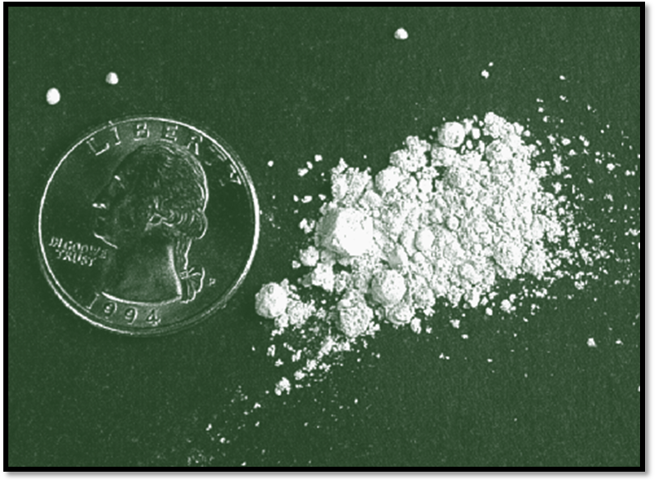
Fig.1 Adding water-soluble packet to a spray tank.
Fig 2. Wettable powders are dry, finely ground formulations that look like dusts

Slide 14
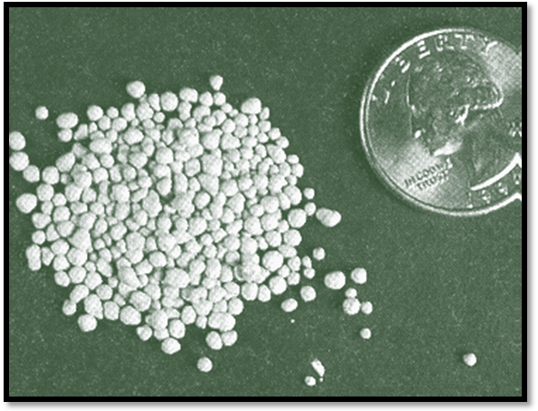
Fig.3 Water-dispersible granule before mixing
Fig.4 Water-dispersible granule after mixing or Dry Flowables

Slide 15
TARGETS
A pesticides needs to be applied to particular ‘target’ areas occupied by an insects pest, disease or weed. Contamination of the environment by chemical drifting out of the area being treated has led to criticism of the use of pesticides, and great concern is naturally caused when the effect of drift are noticed. Certain insecticides kill bees rapidly, while herbicides such as 2, 4-D can damage the crops, sometimes several kilometer downwind. DDT applied to a cotton crop can result in unacceptable residues in tobacco or Lucerne in field downwind.

Slide 16
Insect Control
The concept of crop protection has aimed at reduction in the population of the development stages of the pest directly responsible for damage within individual fields. Crops protection is most efficient when the pesticide is applied economically on a scale dictated by the area occupied by the pest and the urgency with which the pest population has to be controlled. Control has been directed at the larval stage of many insect pests. This policy has been undoubtedly successful when treatment has been sufficiently early to reduce the amount of larval feeding.

Slide 17
Control Strategy
As the principal objective in the control of locusts is to prevent their immigration from breeding sites, the target is the vegetation on which young wingless hoppers typically feed.
Type of Pesticides
Grouping pesticides according to their mode of action is sometimes of more practical importance than a classification based on chemical structure, since it many affect selection of an application technique. Insecticides may be effective;
  By contact
  As a stomach poison
  Fumigant effects.

Slide 18
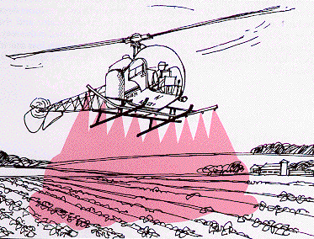
Fig. 5 Aerial Spraying

Slide 19
Droplet Size
Importance of Droplet Size
Sprays contain a large number of droplets, i.e. very small spheres of liquid, mostly less than 0.5 mm in diameter. Droplet size is highly important if pesticides are to be applied efficiently with the minimum contamination of the environment. Pesticidal sprays are generally classified according to the droplet size. Classification is shown as following table
Volume median diameter of droplets (µm) | Droplet Size Classification
< 50 | Aerosol
51 – 100 | Mist
101 – 200 | Fine Spray
201 – 400 | Medium Spray
400 > | Coarse Spray

Slide 20
Spray Distribution
The distribution of spray on foliage and other targets can be assessed by adding a fluorescent tracer to the spray and examined deposits under UV light. Insoluble micronized powder such as zinc, sulphide, Saturn yellow have been widely used as tracers, but require careful mixing with a suitable surfactant before the spray is diluted to the correct volume. Fluorescent oil soluble dyes have been added to spray oil to observe spray coverage.
Determination of Droplet Size
Numerical techniques have been developed to sample and measure droplet size under particular conditions. Modern techniques include high speed photography, laser, and holography and sophisticated scanning techniques. Selections of the most widely used methods are
  Sampling Surface
  Measurements of droplets

Slide 21
Atomizing Devices
Nozzles
Spray liquid is held in a container from which it is moved by pump pressure or gravity feed system to one or more outline called nozzles.
Nozzle Description
Nozzle types commonly used in low-pressure agricultural sprayers include: fan, hollow-cone, full-cone, and others. Special features such as air induction (AI) and drift reducing (DG) are available for some nozzles.
Types
    Fan Nozzle
    Flood Nozzles
    TurfJet Nozzles
    Hollow-Cone Nozzles
    Full-Cone Nozzles,etc.

Slide 22
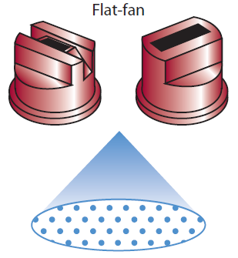
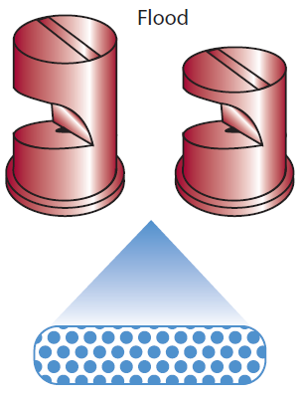
Fig.6 Flat Fan
Fig.7 Flood Nozzle

Slide 23
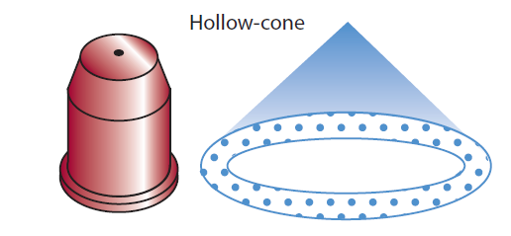
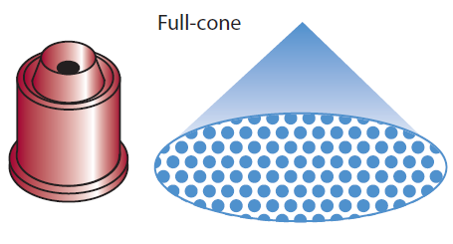
Fig.8 Hollow-Cone Nozzles
Fig.9 Full-Cone Nozzles

Slide 24
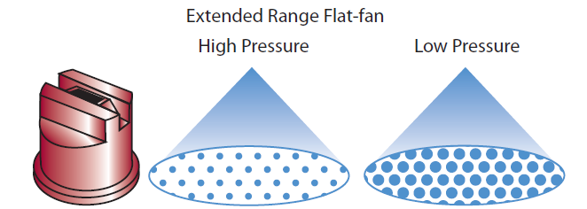
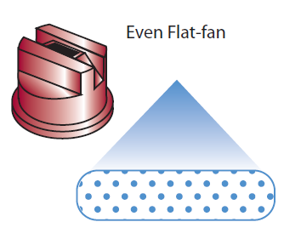
Fig.10. Extended Range Flat Fan
Fig.11 Even Flat Fan

Slide 25
Sprayers
Sprayer
Sprayer is a machine to apply fluids in the form of droplets.
Sprayer is used for the following purpose
  application of fungicides to minimize fungal diseases,
  application of insecticides to control insect pests,
  application of herbicides to remove weeds,
  application of micronutrients on the plants.
Functions of sprayer
  to break the liquid into droplets of effective size,
  to distribute them uniformly over the plants,
  to regulate the amount of liquid to avoid excessive application.

Slide 26
Sprayer’s classification
Based on power source, sprayers may be classified as:
  Hand operated machines – suitable for small holdings. They are operated at pressure ranging from 1 to 7 kg/cm2.
  Power operated machines – suitable for treating a large area. They are operated at pressure ranging from 20 to 55 kg/cm2.
  Air planes – suitable for large scale work.
Based on spray volume, sprayers may be classified as:
  High volume sprayer - More than 400 litres of spray liquid per hectare
  Low volume sprayer – Spray volume ranges between 5 to 400 litres per hectare
  Ultra-Low volume sprayer – Spray volume less than 5 litres per hectare
Based on working principle, sprayers may be classified as:
  Hydraulic energy sprayers
  Compression sprayers

Slide 27
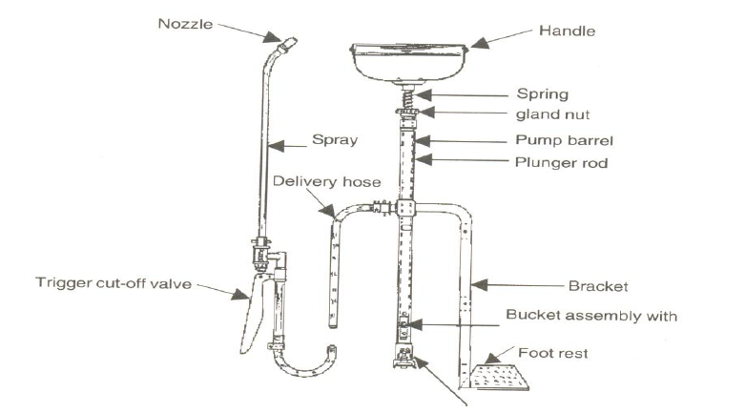
Fig. 12 Bucket type sprayer

Slide 28
Fig.13 Knapsack sprayer

Slide 29
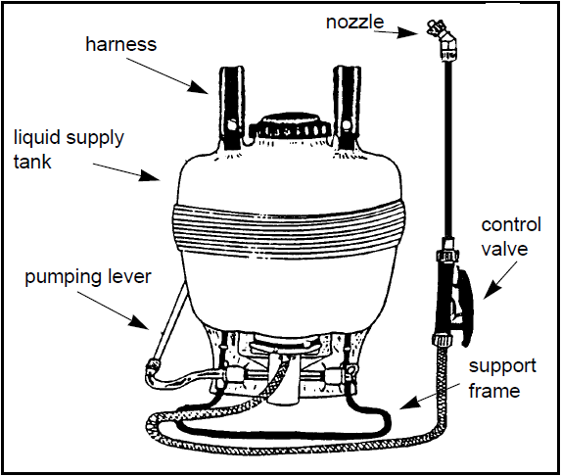
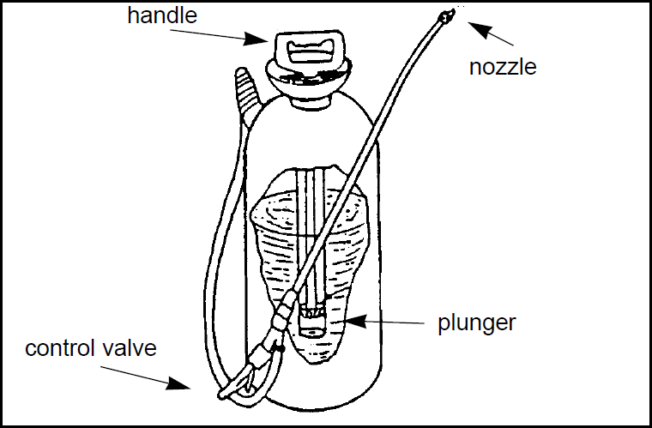
Fig. 14 Backpack Sprayer
Fig. 15 Hand Sprayer

Slide 30
Dust and Granular Applicator
Duster is a machine to apply chemical in dust form. Dusters make use of air streams to carry pesticides in finely divided dry form on the plants. A duster essentially consists of: (a) hopper, (b) agitator, (c) feed control, (d) fan or blower and (e) delivery nozzle.
Types of dusters
1) Plunger type hand duster
This machine consists of a chamber for the dust, outlet, a cylinder with piston, piston rod and handle. Sometimes the dust chamber is placed below the cylinder. By moving the piston back and forth in the cylinder, dust is forced through the outlet. This type of duster is suitable for dusting a small area.

Slide 31
2) Rotary type hand duster
This type of duster is provided with an enclosed fan geared to a hand crank and a hopper holding the dust. It is equipped with an agitator to stir the dust and a regulator to control the discharge opening. The duster is usually fastened to the operator by means of shoulder strips. The right hand is used for cranking and the left hand to guide the discharge tube. These dusters can hold about 3.6 to 4.5 kg of dust and are large enough to treat 0.4 to 0.6 hectare of cropped area in a day. Ordinarily they are not found suitable for dusting over 3 meters height.

Slide 32
3) Power duster
The power duster of small capacity is generally mounted on the back of the operator. It consists of cylindrical container, blower, high speed engine and discharge hose pipe. The cylindrical container is provided with two compartments, one for gasoline, and the other for the powder to be dusted. The blower is directly mounted on the crankshaft of the high speed (4000 rpm) air cooled engine. The air pressure is utilized to agitate the dust in the container in order to blow it through the flexible hose

Slide 33
Fig. 16 Rotary Duster

Slide 34
Care and maintenance of dusters
Duster should be thoroughly cleaned before and after use with a suitable brush.
The hopper should be filled with dust about half of its capacity.
The lid of the hopper should be closed during the operation.
In rotary dusters, the handle should be cranked at 30 to 35 rpm for efficient performance
Before and after use of the duster, the dust from the fan box, suction pipe and hopper should be thoroughly blown out.
Pieces of paper, gunny bag and other foreign materials should be prevented from getting into the hopper.
The agitator parts and dust feed should be occasionally checked for blockage by foreign matter.

Slide 35
Safety Precaution
Always wear personal protection equipment required by the insecticide label.
Keep stopper and caps on all dusters while not in use and while transporting the duster
Always follow label directions on dust or granular insecticides.

Slide 36
Trouble Shooting
Problem: Dust leaking around the cap
Solution: • Tighten the cap
• Replace the seal in the cap
Problem: Not enough dust delivered with each stroke
Solution: • Turn unit until the siphon tube is at the bottom, resting in the dust
• Add marbles to container to keep dust from clumping
Problem: Dust leaking around the handle
Solution: • Clean around the check valve at the bottom of the pump cylinder
• Replace the check valve.
Problem: Granules not delivered through the siphon tube
Solution: • Upper siphon tube in Long Reach Dust-R must be plugged
• Not enough dust or granules in container
• Some granular formulations have different size particles, and some are too large for the siphon

Slide 37
Thank you…

